Slide 1
Spectral analysis
Kenneth D. Harris
18/2/15

Slide 2
Continuous processes
A continuous process defines a probability distribution over the space of possible signals
Sample space =
all possible LFP signals
Probability density 0.000343534976

Slide 3
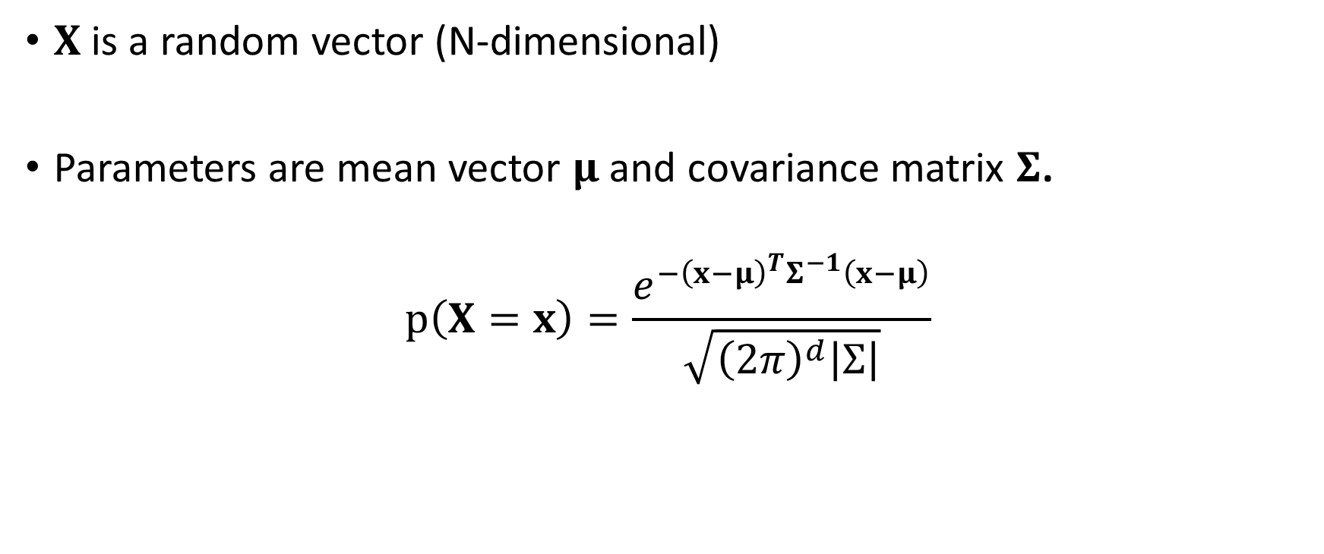
Multivariate Gaussian distribution
$X$is a random vector (N-dimensional)
Parameters are mean vector $μ$ and covariance matrix $Σ$.
$$p\left(X=x\right)=\frac{e^{−{\left(x−μ\right)}^{T}Σ^{−1}\left(x−μ\right)}}{\sqrt{{\left(2π\right)}^{d}\left|Σ\right|}}$$

Slide 4
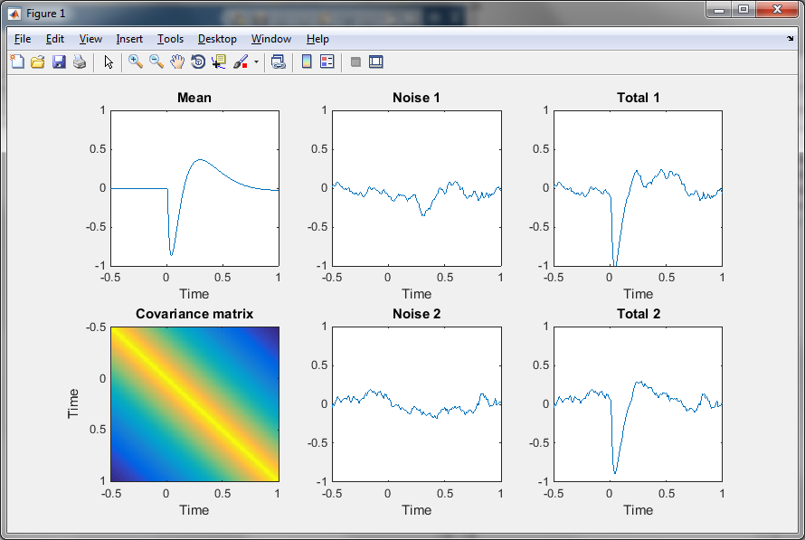

Gaussian process
Time series ${(x}_{0},x_{1},x_{2},…, x_{N−1})=x$ , Gaussian distributed

Slide 5

Stationary Gaussian process
  $Σ_{i,j}=A\left(i−j\right)$.
    $Σ$ is a Toeplitz matrix
  $A\left(Δt\right)$ is autocovariance function
  $μ_{i}$ is a constant, usually 0.

Slide 6
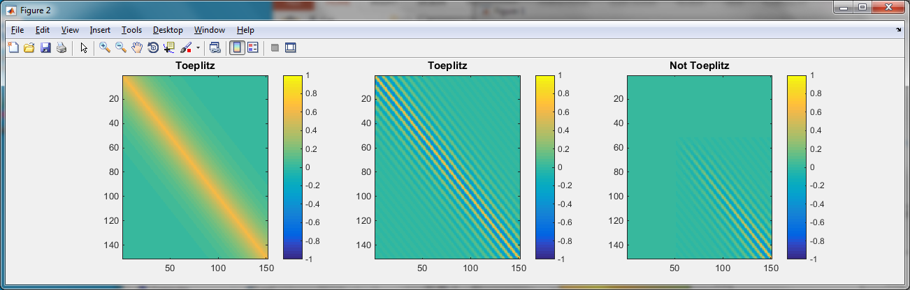
Types of covariance matrix

Slide 7
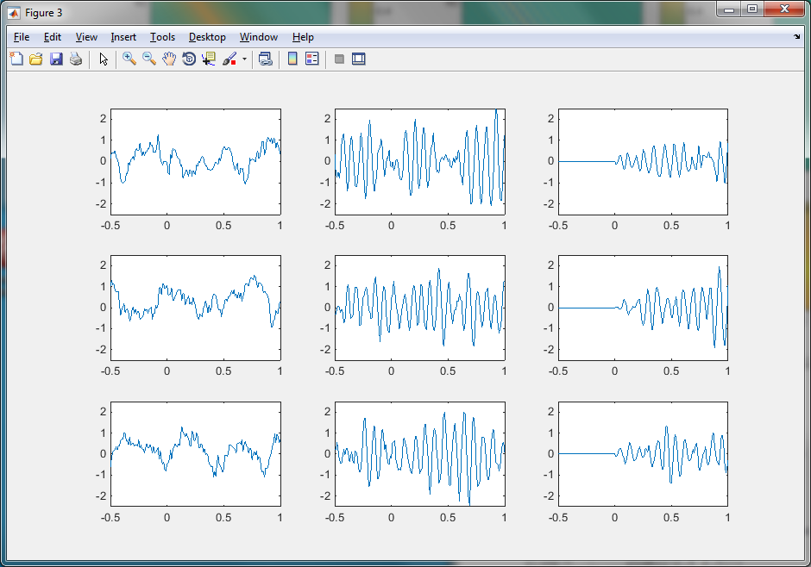
Which are stationary?

Slide 8
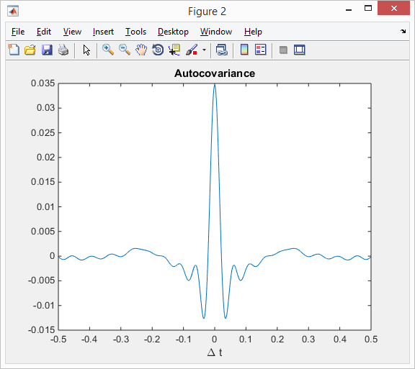

Autocovariance
Autocovariance $A\left(Δt\right)=E\left(x\left(t\right) x\left(t+Δt\right)\right)$
It is a 2nd order statistic of $x(t)$
$A\left(0\right)=Var\left(x\right)$

Slide 9
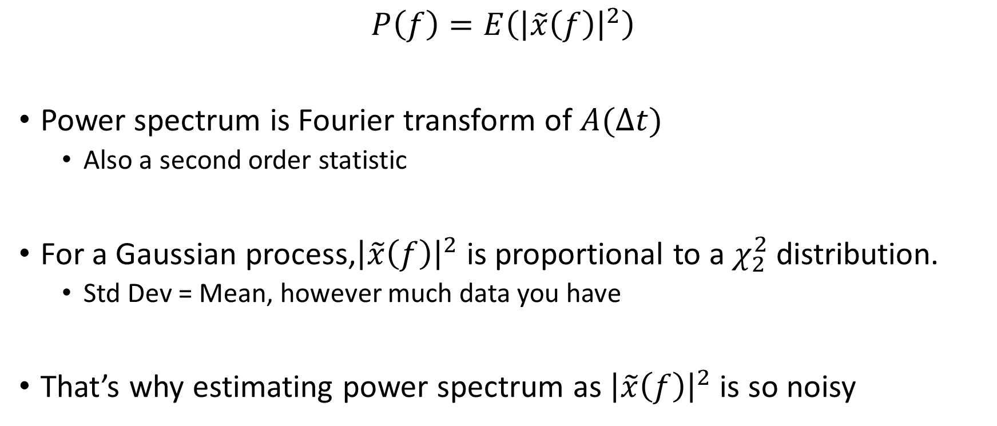
Power spectrum estimation error
$$P\left(f\right)=E\left({\left|\tilde{x}\left(f\right)\right|}^{2}\right)$$
Power spectrum is Fourier transform of $A(Δt)$
  Also a second order statistic
For a Gaussian process,${\left|\tilde{x}\left(f\right)\right|}^{2}$ is proportional to a $χ_{2}^{2}$ distribution.
  Std Dev = Mean, however much data you have
That’s why estimating power spectrum as ${\left|\tilde{x}\left(f\right)\right|}^{2}$ is so noisy

Slide 10

Power spectrum estimation
Need to average ${\left|\tilde{x}\left(f\right)\right|}^{2}$ to reduce estimation error
If you observe multiple instantiations of the data, average over them
  E.g. multiple trials

Slide 11
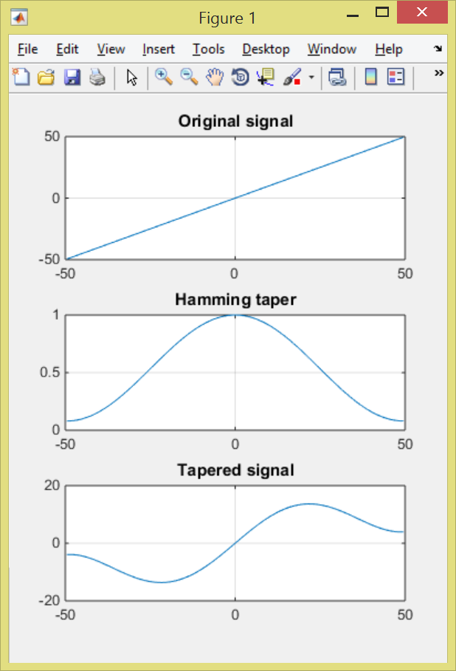
Tapering
Fourier transform assumes a periodic signal
Periodic signal is discontinuous => too much high-frequency power

Slide 12
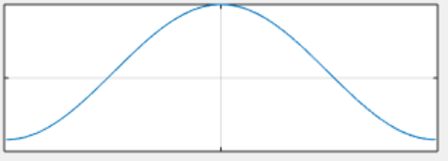
Welch’s method
Average the squared FFT over multiple windows
Simplest method, use when you have a long signal

Slide 13
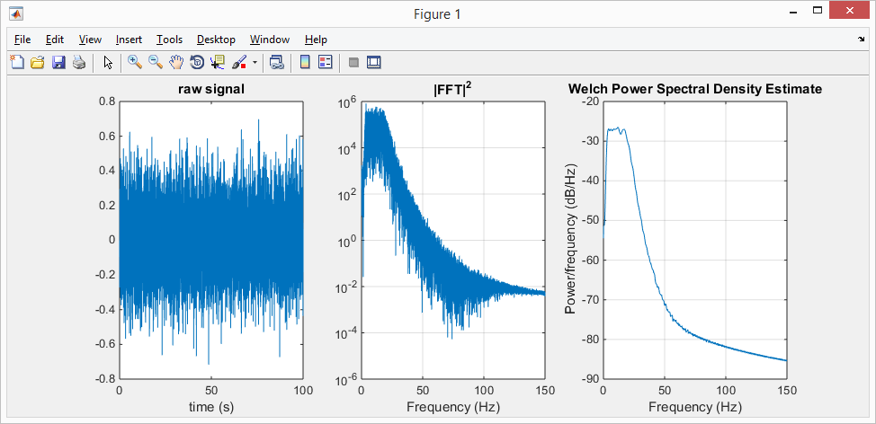
Welch’s method results (100 windows)

Slide 14
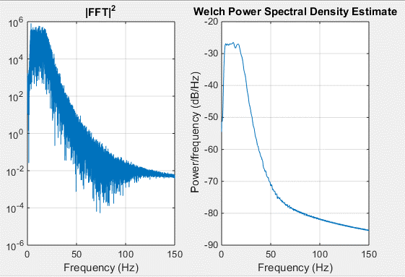
Averaging in time and frequency
Shorter windows => more windows
  Less noisy
  Less frequency resolution
Averaging over multiple windows is equivalent to averaging over neighboring frequencies

Slide 15
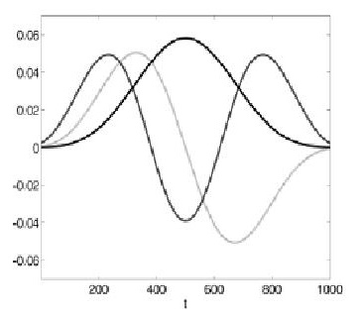
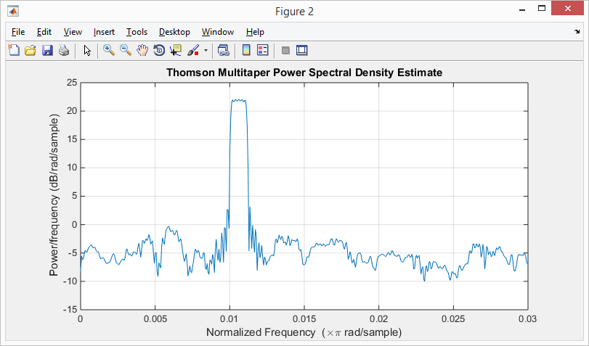

Multi-taper method
Only one window, but average over different taper shapes
Use when you have short signals
Taper shapes chosen to have fixed bandwidth

Slide 16
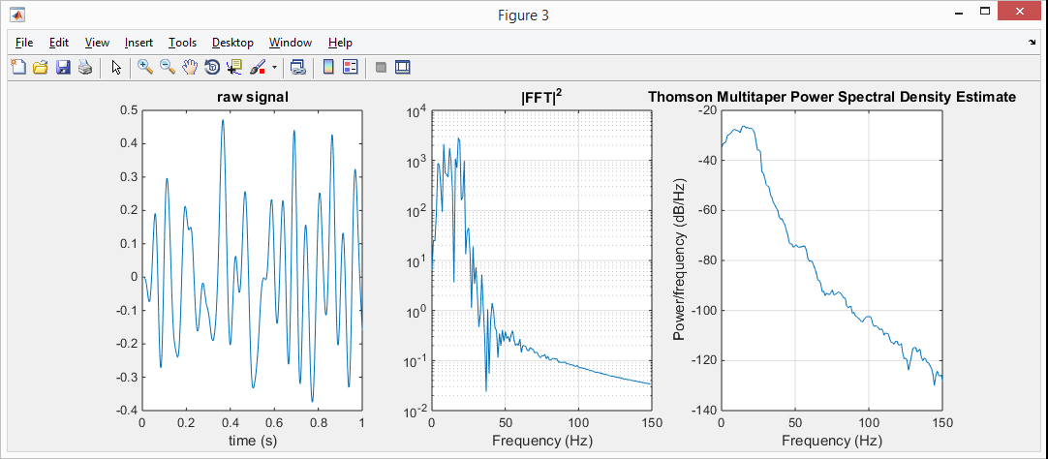
Multitaper method (1 window)

Slide 17


http://www.chronux.org/

Slide 18
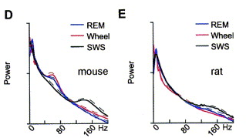
Hippocampus LFP power spectra
Typical “1/f” shape
Oscillations seen as modulations around this
Usually small, broad peaks
CA1 pyramidal layer
Buzsaki et al, Neuroscience 2003

Slide 19
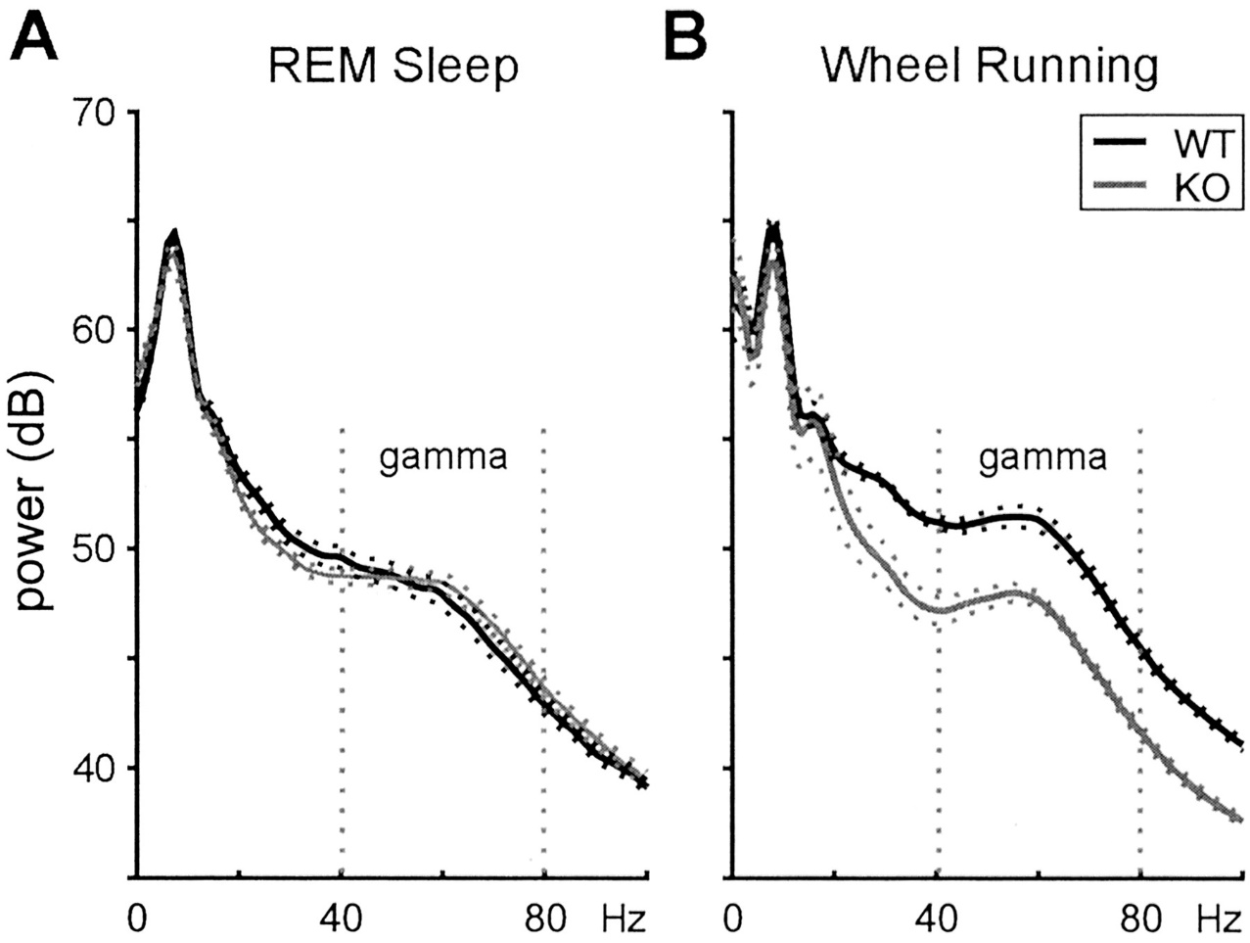
Connexin-36 knockout
Buhl et al, J Neurosci 2003

Slide 20
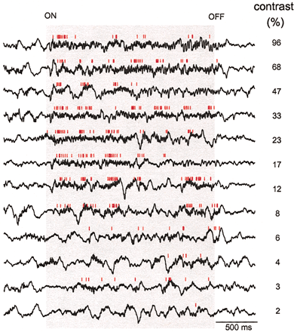
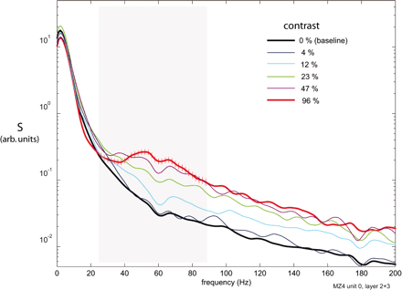
Stimulus changes power spectrum in V1
High-frequency broadband power usually correlates with firing rate
Is this a gamma oscillation?
Henrie and Shapley J Neurophys 2005

Slide 21
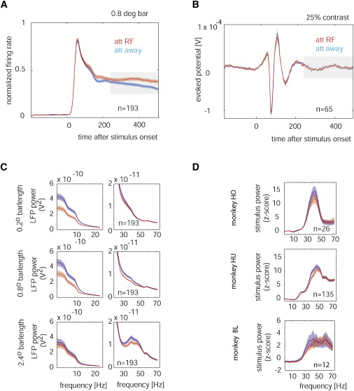
Attention changes power spectrum in V1
Chalk et al, Neuron 2010

